Slide 1
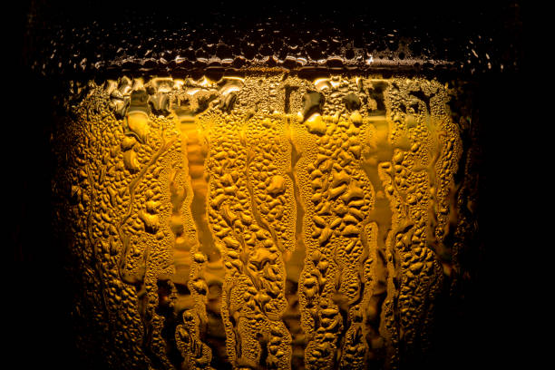
BEER
A golden business opportunity
By Jesús Brito

Slide 2
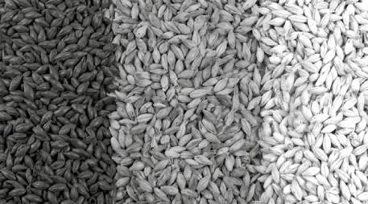
01
02
03
04
05
06
TABLE OF CONTENTS
PROJECT INTRODUCTION
DATA SELECTION
BEER STYLES AND ATTRIBUTES
WHAT ARE THE TRENDS? (EDA)
GAPS AND OPPORTUNITIES
CONCLUSIONS AND RECOMMENDATIONS

Slide 3
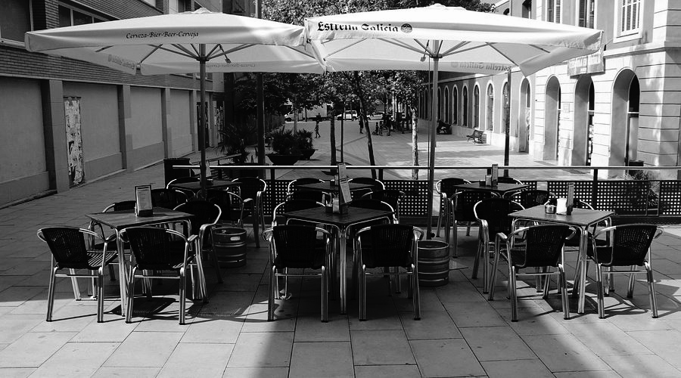
OBJECTIVE
AND MOTIVATION
Personal context
Terraza’s life
Identify the best and most popular beers globally and locally to find business opportunities in the local Spanish market for big/traditional breweries
Notes:
160ml of beer daily = Penalti, corto, cañita, zurito, caña
Biergarten vs terrazas
Lack of variety and new things

Slide 4
JARGON
IBU
SRM
ABV
Light
Regular
Strong
Gold
Light brown
Light dark
Dark
Low
Moderate
High
Notes:
ABV Alcohol By Volume max 100% (Brewmeister - Snake Venom. 67.5%)
SRM Standard Reference Method 1-40 (Stout darkest and lager)
IBU International Bitterness Unit max 100 (IPA between 40 and 70)

Slide 5
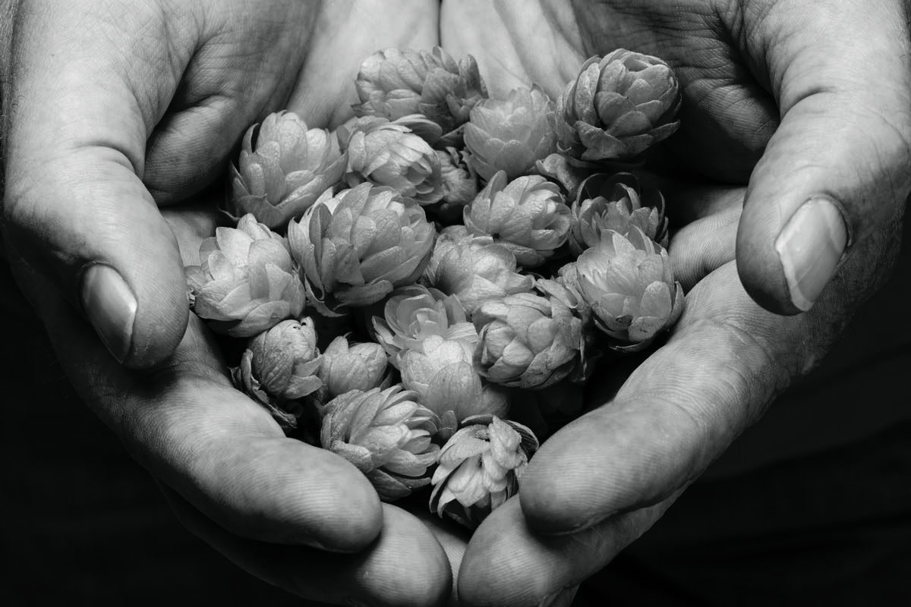
Choosing and cleaning the data
CHOOSING THE DATA
Beer Advocate dataset from Kaggel.com
Scrapping (Craftbeer.com, Untapped & Beer Advocate)
COMPLICATIONS
Huge dataset
Mixed and new styles
Not updated
Scrapping not allowed
CLEANING THE DATA
Most recent data
Create bins instead of mapping
Unifying styles or dropping

Slide 6
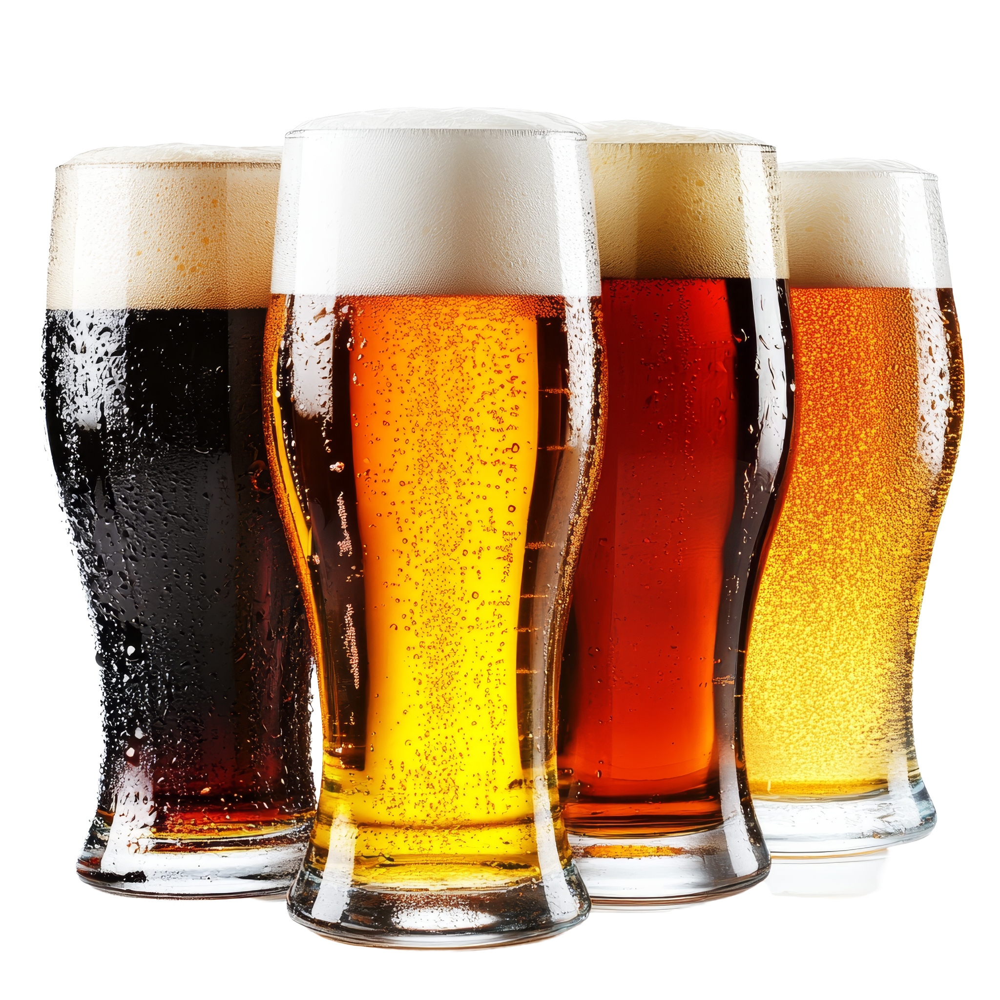
REVIEWS AND STYLES
Evaluation parameters
What makes a beer good and popular?
Aroma
Appearance
SRM
IBU
ABV
Taste
Palate

Slide 7
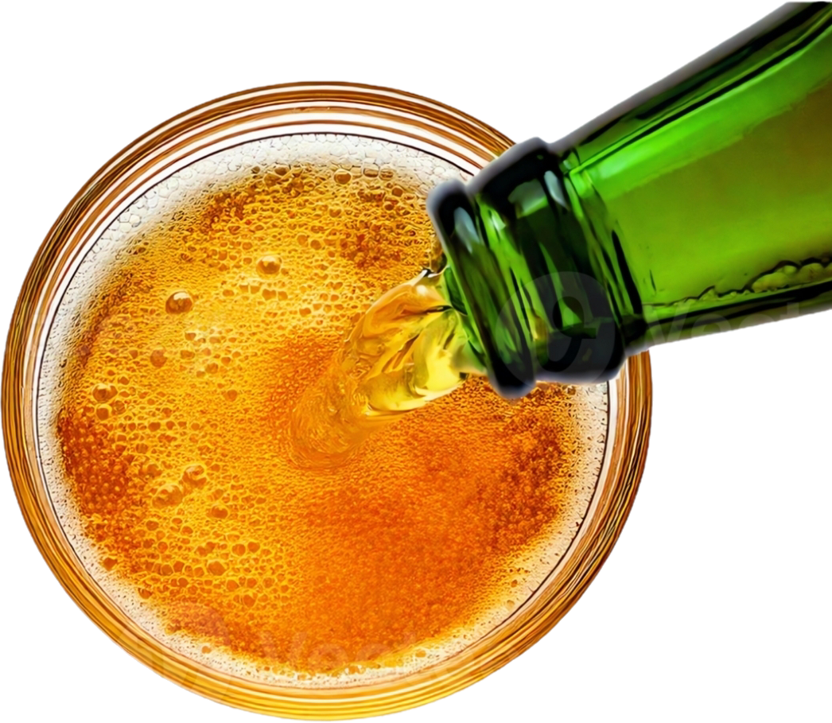
WHAT DO WE KNOW
SO FAR?
TASTE
LIGHT
BROWN
🍧
🍫
PALATE
🎨
MODERATE
🌿
DIFFERENT
REGULAR
🆕
💪

Slide 8
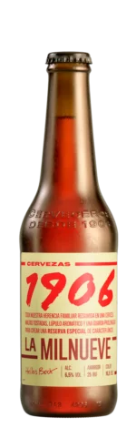

GAPS AND OPPORTUNITIES
ABV 6.5%
IBU 25
SRM 16
BELGIAN-ISH Helles Bock
TASTE: Bit bitter, long and pleasant aftertaste.
APPEARANCE: Amber.
PALATE: Thick, dense and round.
AROMA: hops and roasted malt.

Slide 9
FINDINGS AND RECOMMENDATIONS
Identify preferences.
Find business opportunities.

Slide 10
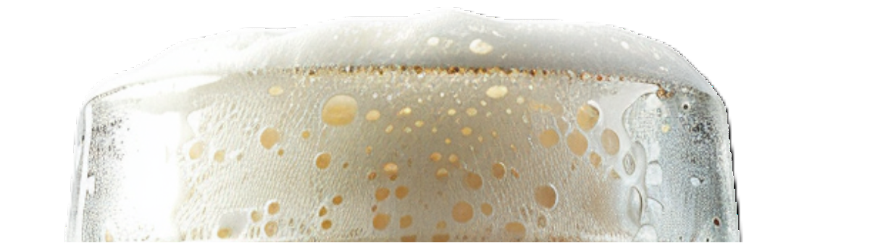
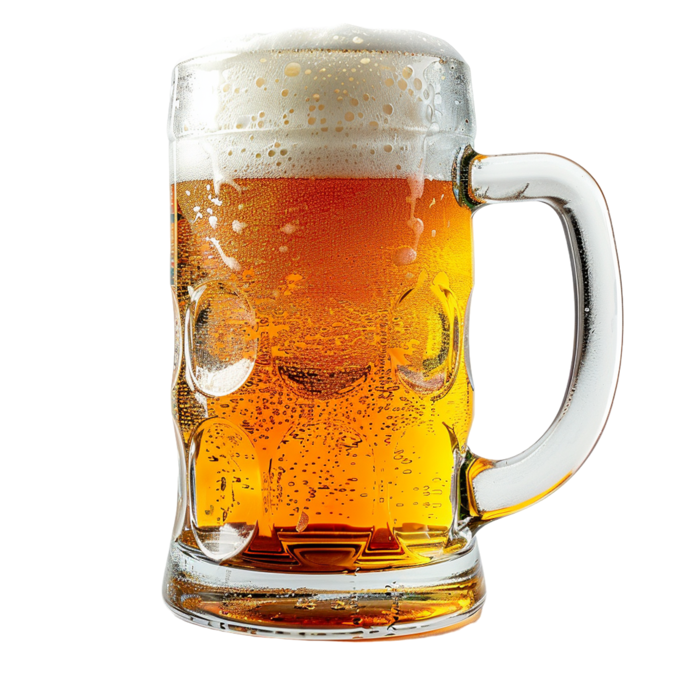
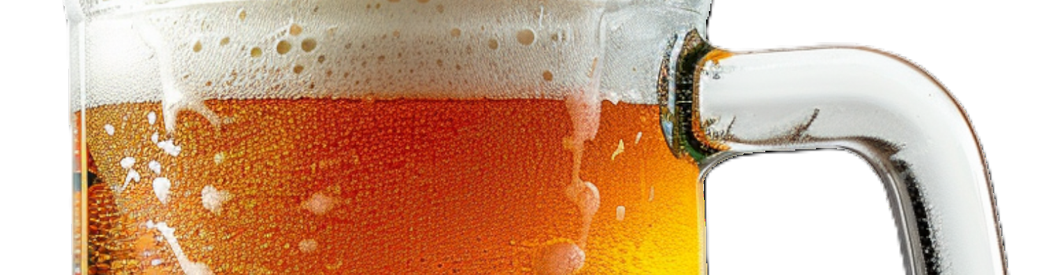
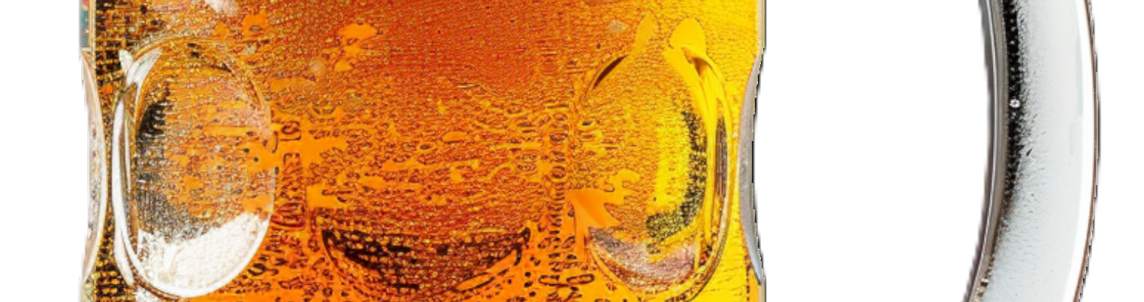
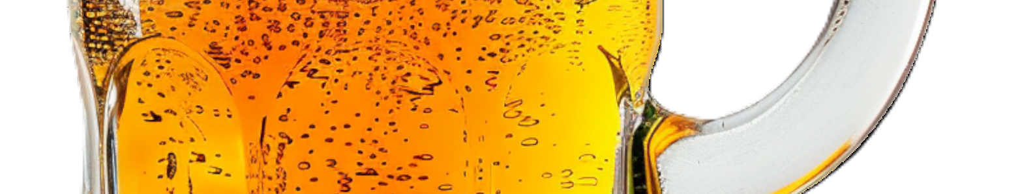

FINDINGS AND RECOMMENDATIONS
There is a niche market for high-quality, less common beer styles that can thrive even without mainstream appeal.
High ratings is not equal to popularity.
Popularity is not equal to high ratings.
Taste is a key feature.
Beer drinkers are open to try new beers.
There’s no math equation for the perfect/popular beer.

Slide 11
FINDINGS AND RECOMMENDATIONS
Recommendations for local breweries
Market research to study the performance of the 1906 Reserva Especial.
Launch a beer with the same characteristics and take on the market opportunity.

Slide 12
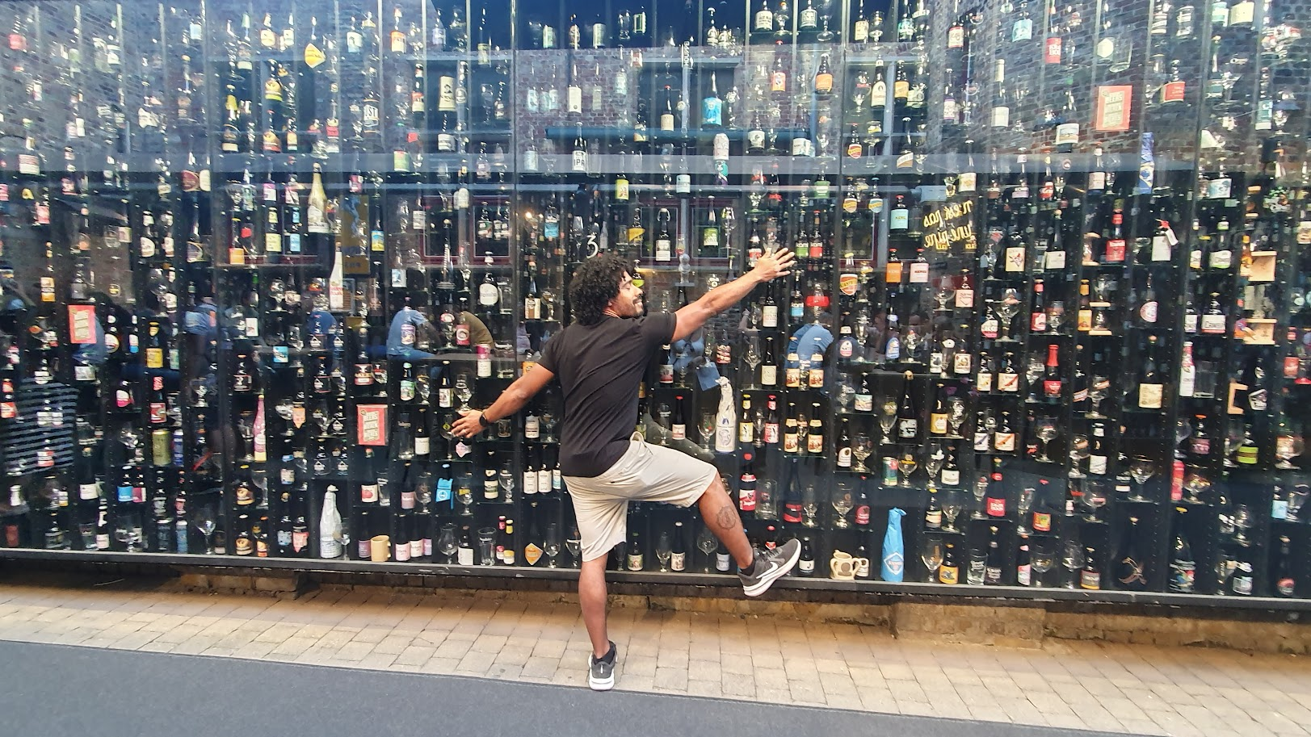
THANK YOU!

Slide 13


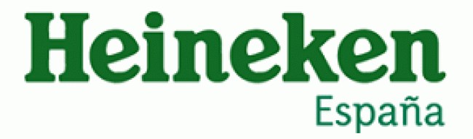
GAPS AND OPPORTUNITIES
4
7
6
5
REGULAR ABV

Slide 14
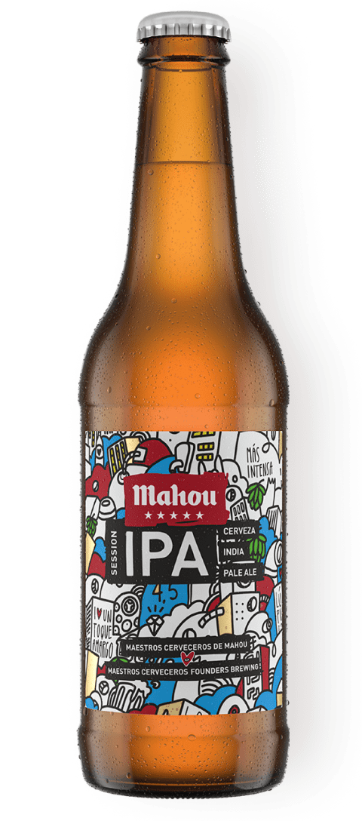
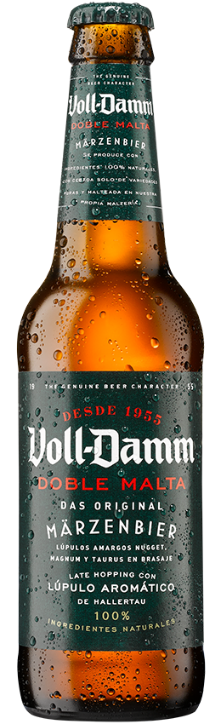
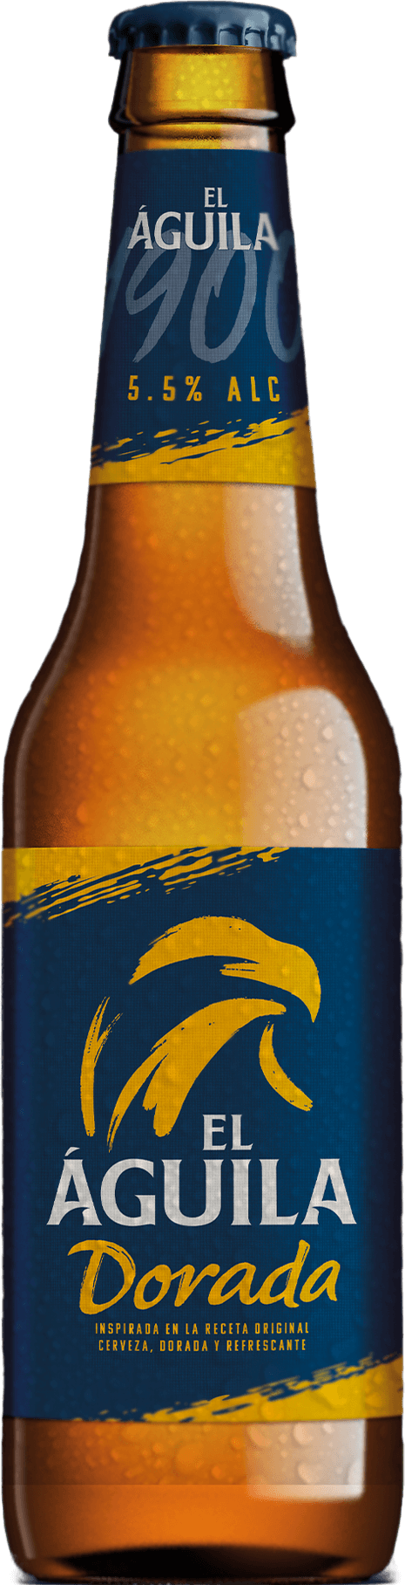
GAPS AND OPPORTUNITIES
MODERATE IBU

Slide 15
GAPS AND OPPORTUNITIES
REGULAR SRM

Slide 16
“Egy sör, nem sör.
Két sör, fél sör.
Három sör, majdnem sör.
Négy sör, egy sör.
De, mint tudjuk, egy sör, nem sör.”
"One beer is no beer.
Two beers is half a beer.
Three beers is almost a beer.
Four beers is one beer.
But, as we know, one beer is no beer."

Slide 17
“Beer is the proof that
God loves us and
wants us to
be happy”
34.7
0.35l
Unknown
450k
4l
SPACE
MONK
Notes:
1.- Germany was the top producer with 7.2 billion liters, followed by Spain with 4.0 billion liters.
2.- Average liters per Czech
3.- in ES direct or indirect jobs
4.- Egypt builders 4l per day
5.- due to lack of gravity the carbon dioxide did not separate from the liquid.
6.- Brewed for diet, sanitary reasons and profit

